Slide 1
WEB-ENABLED MALARIA DETECTION USING DEEP LEARNING
MENTOR
Mrs.R.Narmatha M.E.,
Assistant Professor,
Government College of Engineering,
Dharmapuri.
PRESENTED BY:
Rajesh R (613521104032)
Shenjin S A Solomon (613521104043)
Santhosh Kumar S (613521104309)
Tharun Raj R (613521104311)

Slide 2
TABLE OF CONTENTS:
Introduction
Objective
Literature Survey
System Requirements
Existing System
Proposed System
System Architecture
Dataset Training Module
Testing Module
Output
Conclusion
References

Slide 3
INTRODUCTION:
Malaria is a life-threatening disease caused by parasites transmitted to humans through the bites of infected mosquitoes.
It remains a major public health challenge in many tropical and subtropical regions, particularly where access to medical diagnostics is limited.
Traditional diagnosis involves examining blood smear slides under a microscope, a process that is time consuming , labour intensive , prone to human error.

Slide 4
OBJECTIVE:
To develop a deep learning-based web application that:
Accurately classifies red blood cell images as parasitized or uninfected
Uses InceptionV3 for efficient feature extraction
Provides real-time predictions via a user-friendly interface
Aims to assist healthcare workers in early and accurate diagnosis

Slide 5
LITERATURE SURVEY:
Title / Approach | Authors | Key Features | Advantages | Disadvantages
Hybrid CNN + BiLSTM + Attention | D.A. Jadhav, C., Rani (2024) | Combines CNN with BiLSTM and attention for spatial-temporal feature learning | High detection accuracy; context-aware learning | High computational cost; long training time
VGG16 + InceptionNet Hybrid | Dev Kumar (2018) | Integrates two CNNs to enhance feature extraction | Improved accuracy; robust spatial understanding | Requires large datasets; slow training
ResNet50 + DenseNet121 Ensemble | W. David, Yuhang Dong (2022) | Extracts both low- and high-level features from blood smear images | Robust to image quality variations | Computationally intensive; not ideal for real-time use

Slide 6
SYSTEM REQUIREMENTS:
Hardware Requirements:
Intel Core i5 or above
16 GB RAM
GPU-enabled system
500 GB SSD
Software & Tools:
Python 3.7+, TensorFlow/Keras
Flask, PIL, Pandas, NumPy
Visual Studio Code, Google Colab
Ngrok (for web hosting)

Slide 7
EXISTING SYSTEM:
Manual microscopy: time-consuming & error-prone.
Requires skilled technicians to analyse.
Traditional ML: lacks generalizability & accuracy.
No real-time automation.
High computational needs and poor usability.

Slide 8
PROPOSED SYSTEM:
Hybrid deep learning model with InceptionV3
Web-based interface using Flask
Supports both single and batch predictions
Real-time malaria diagnosis with image preprocessing and classification
Scalable, fast, and suitable for clinical environments

Slide 9
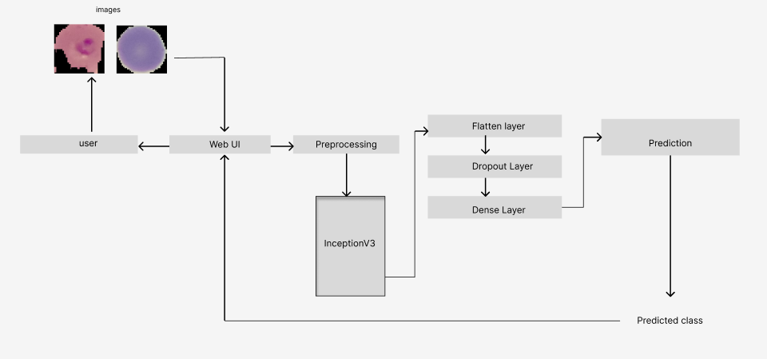
SYSTEM ARCHITECTURE:

Slide 10
SYSTEM ARCHITECTURE:
User uploads image via Web UI.
Image is preprocessed (resized, normalized).
InceptionV3 extracts features.
Flatten, Dropout, Dense layers perform classification.
Prediction is sent back to user in real time.

Slide 11
DATASET:
Source: NIH Malaria Cell Images Dataset
Approx-27,558 images
Two classes: Parasitized and Uninfected
JPEG/PNG format
Split: 80% Training, 20% Testing
Augmentation applied: flipping, brightness, rotation

Slide 12
TRAINING MODULE:
Input size: 128x128
Model: InceptionV3 with custom classification layers
Augmentation: ImageDataGenerator
Optimizer: Adam, Loss: Binary Cross-Entropy
Epochs: 5+
Accuracy: Reached ~98% training accuracy and ~97% validation accuracy

Slide 13
TESTING MODULE:
Users can upload single or multiple blood smear images through the web interface.
Each image is processed through a series of steps:
Image validation and preprocessing
Prediction using the trained model
Display of result (Infected or Uninfected)

Slide 14
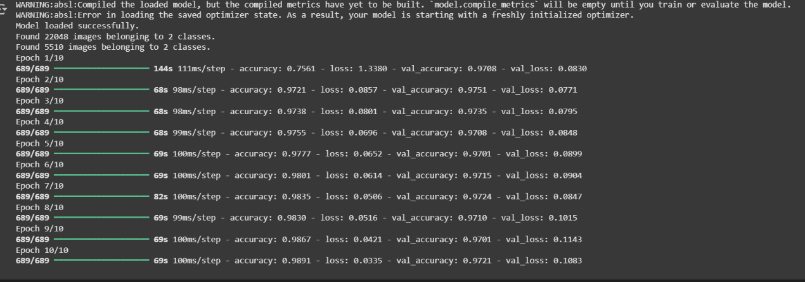
OUTPUT:

Slide 15
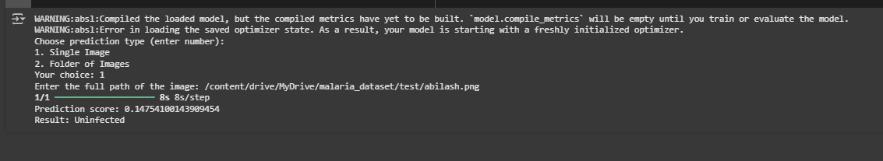
OUTPUT:

Slide 16
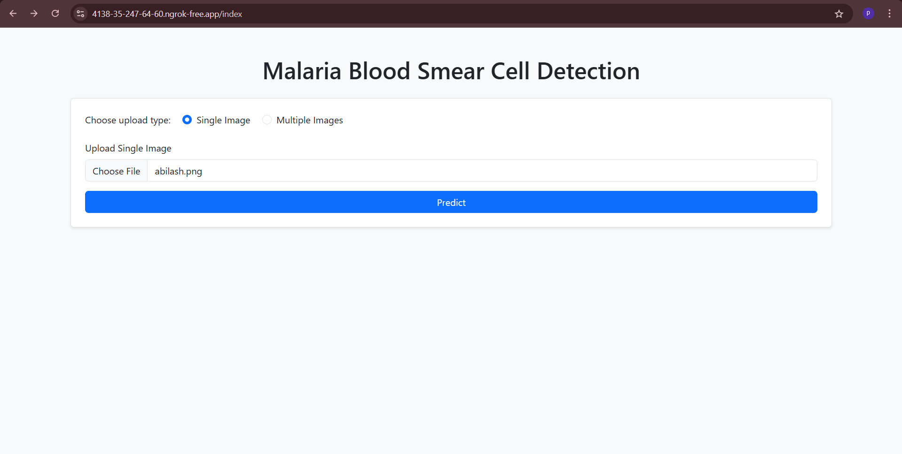
OUTPUT:

Slide 17
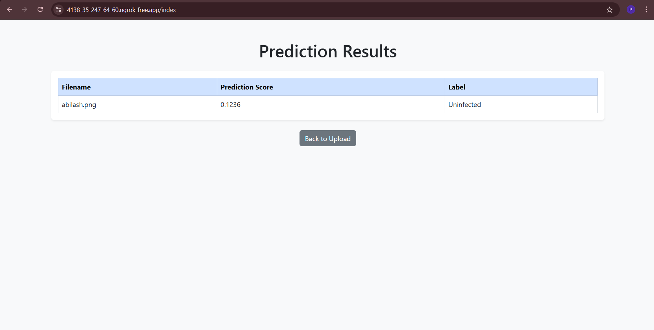
OUTPUT:

Slide 18
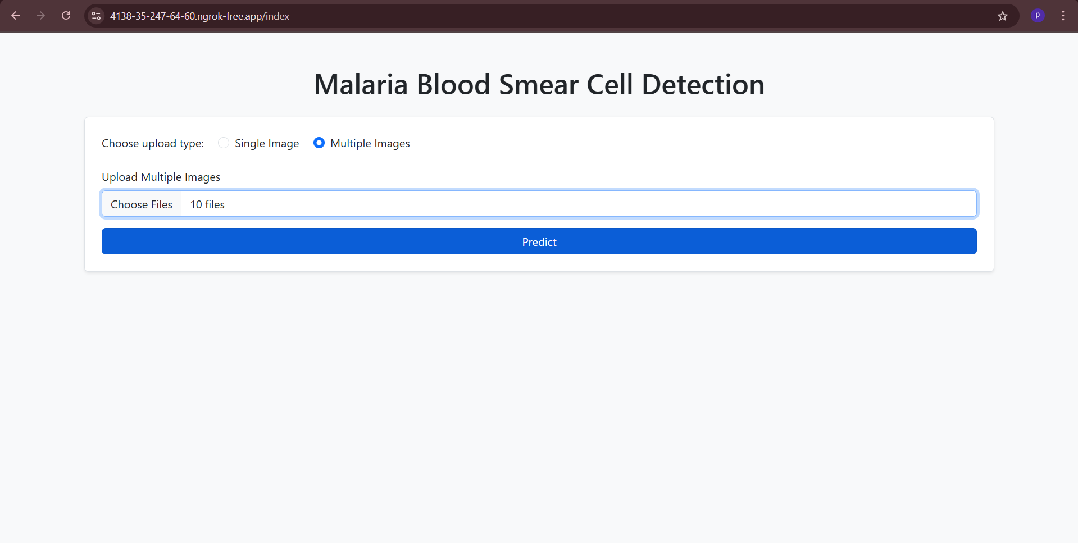
OUTPUT:

Slide 19
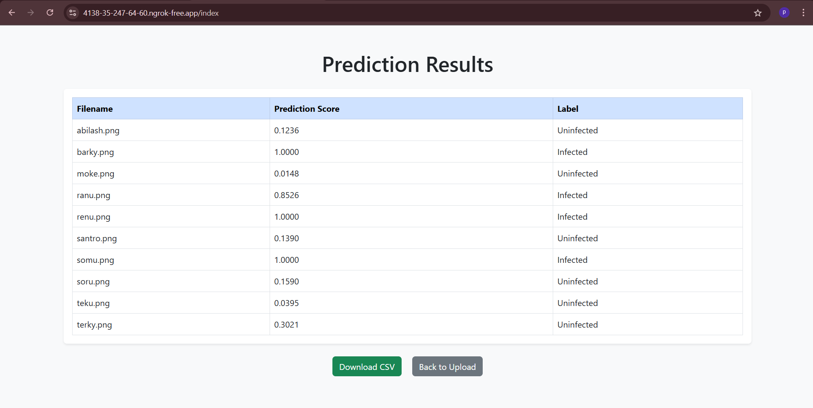
OUTPUT:

Slide 20
CONCLUSION:
The project developed a reliable deep learning-based malaria detection system with high accuracy.
It integrates a practical web interface for real-time, user-friendly diagnosis.
This scalable solution is ideal for deployment in resource-limited healthcare settings.

Slide 21
FUTURE ENHANCEMENTS:
Detect more malaria stages for better diagnosis.
Create mobile app support for easier access.
Train with more data to improve accuracy.
Use cloud deployment for wider reach of people.
Include automatic report generation with hospitals

Slide 22
THANK YOU!

